Slide 1

Release Plan
TokyoDriftr Release plan version 2. 7/3/2020
Conrad Menchine, Kevin Pinney, Luke Harvey

Slide 2
High Level Goals
Playable driving game with “drifting”
Collision detection to keep players in course, win detection and timer
Randomly generated “set” from fixed assets
Selectable cars with different specs

Slide 3
Sprint One
Priority | TokyoDriftr (User Stories) | Story Point Estimate
1 | As a player, I want to apply my ability to control my car | 5
2 | As a Player, I want my ability to control the car to matter when placed inside a world | 5
3 | As a user, a want a new unique map to try to compete on a regular basis. | 3
4 | As a User I want to open the website and understand the controls and start playing quickly | 3
5 | As a user, I would like to know how my performance compares to others | 5

Slide 4
Sprint Two
Priority | TokyoDriftr (User Stories) | Story Point Estimate
1 | As a game owner, I would like maps to generate themselves so I don’t have to create them | 8
2 | As a User, I would like to be able to select my car | 5
3 | As a User I would like interesting rendering effects | 3

Slide 5
Sprint Three
Priority | TokyoDriftr (User Stories) | Story Point Estimate
1 | As a User I would like a procedurally decorated set | 8
2 | As a User I would like to be able to create and share my own maps | 8
3 | As a User, I want interesting particle effects | 3

Slide 6
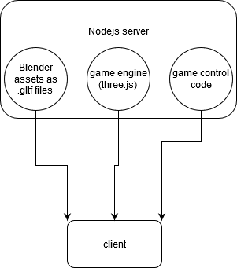
Architecture
Very simple client-server system
In the most basic form, data is served only once from the static server to the client.

Slide 7
Technologies
All Javascript
Blender for 3d work
Node.js w/ Express (Potentially Mongoose for Database)
Three.js

Slide 8
Challenges/Risks
Getting Drifting to feel fluid w/ collision mechanics
Map Creation w/ procedurally generated terrain around the road
Multiplayer is a stretch goal, which if we were to get to that point, would be a substantial undertaking
Dealing with ThreeJS which is a new Technology to all of us

Slide 9
Minimum Viable Product
As a User I would like to drive a car of my choice
As a User I would like to drift with my car
As a User I would like to get a score based on my performance
As a User I would like at least 1 map to drive on

